Slide 1

Meethi Katha
Crisis Starlet
WiT Hackathon – IBM - 2020

Slide 2
Agenda
Problem Statement
Solution
Benefits
Section 1
Section 2
Section 3
Features
Competitor Comparison
Appendix
Section 4
Section 5
Section 6

Slide 3

With the COvid 19 grappling the entire world and all of us trying to make sense of the entire situation, we have also come to realize that the two most vulnerable group our elderly and our Kids, who are also at the highest Risk of contracting Coronavirus, are also the most impacted with the lockdown. ​ ​
Where most of us are busy with juggling multiple calls in our day and getting the job done virtually, we have enough on our plate to not find time to be lonely. (not that it is a good thing !!). However with our attention now more on work almost round the clock, our elderly and our kids are finding it all the more difficult to kill time or speak to someone and feel that they are not alone in this. ​ ​
The idea is to engage these two groups and that’s where the idea originated that if we can try to bring these two groups together. ​ ​
As per an article published by NBC News, Coronavirus is robbing grandparents of precious time with families.
Source: https://www.nbcnews.com/news/us-news/coronavirus-robbing-grandparents-precious-time-families-n1196776
Meethi Katha does exactly that ! ​ ​
We are creating a platform where the Elderly and Kids come together to share some thoughts, stories, life lessons and in that process engage better with each other, appreciate each other and find some solace in the interactions amid these times.
Executive Summary

Slide 4
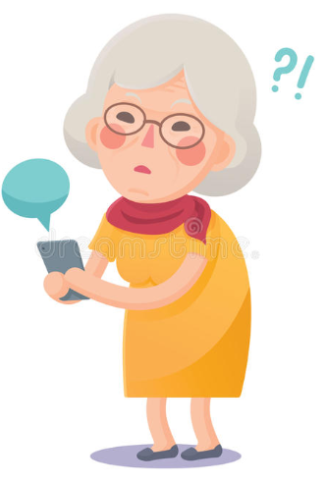
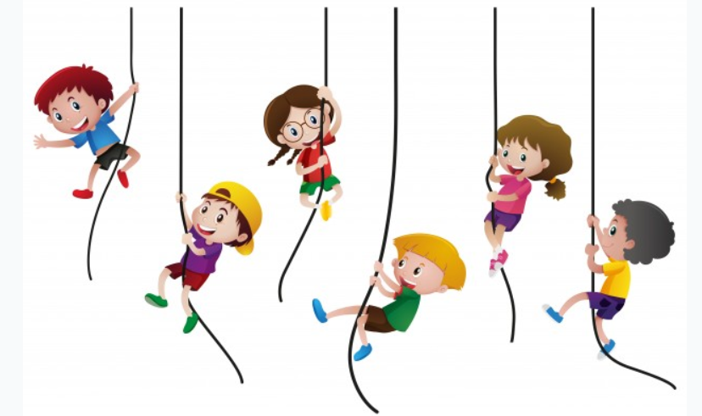
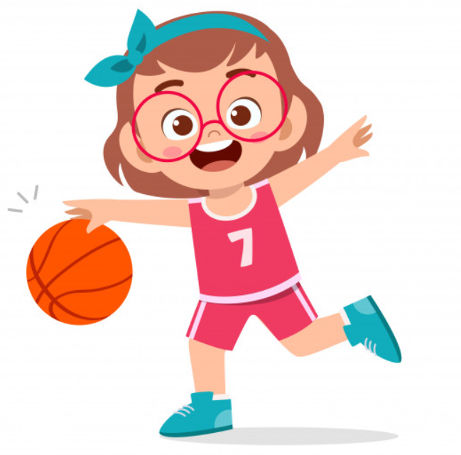
Case Study
The Problem
The most vulnerable in the covid-19 situation are the young and the old. For their own safety, they are restricted to their homes, going through loneliness (expressed / unexpressed)
The old are going through silent loneliness while the young to noisy loneliness.
The need to positively engage the young and wean away from commercial/ non-productive avocations.
Solution
Empower grandparents to connect with the younger generation and share life wisdom
Benefits
Alleviate loneliness between the young & elderly through technology
Preserve our wisdom through productivity engaging children
Bring back the story telling tradition into our homes, to our children and to strengthen the moral grounding.
Boost the confidence of the old generation in the new normal

Slide 5

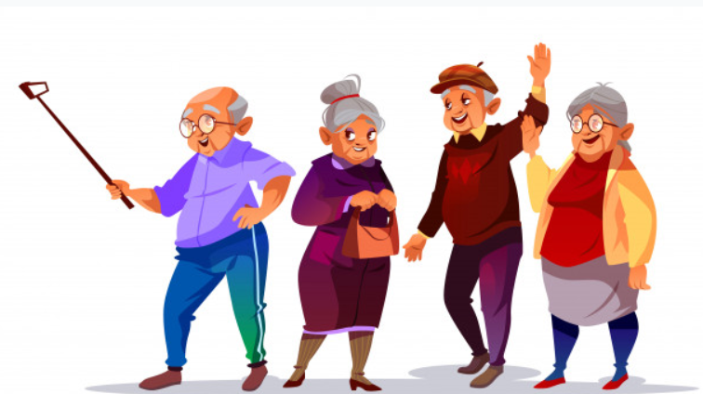


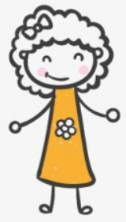
Our Product & Services
Cross-generational interaction tool : A Live interaction with granny’s in different languages and has stories in stories in English, Hindi, Tamil, Telugu, Malayalam, Kannada, Gujarati, Marathi and Bengali. Also, there are stories that will inculcate the Indian culture and heritage among kids such as Grandpa & Grandma, Royal Tales & Legends, etc.
The application aims to entertain kids and make them learn and communicate in their mother tongue.
Stories are divided into somewhat independent chapters, the first of which is always free.
Meethi Katha can help children of 5 to 12 ages listen to the stories in a well-structured and thoughtful ways.
This would be expanded globally and will include games, Life lessons, Cultural view exchange etc.

Slide 6

Video Link
Product Video on YouTube

Slide 7
Solution Roadmap
Live Interactions
Story focused
Multi-lingual
Audio/Video Enabled
Access profile via Facebook, Google
Treasure repository
Recording (Optional)
Pan India rollout with limited languages
Watson Personality Insights for preference building
Career guidance
Webinars
Continue to build and expand the treasure library
Adding more Indian languages to increase target base
games,
Creating Online Family
Form groups based on similar profession, interests
Counselling with the support groups for the kids as well as elderly.
Roll out pan world
Support cross cultural/national groups to further share the precious knowledge
Meethi Katha 3.0
Meethi Katha 2.0
Meethi Katha 1.0

Slide 8
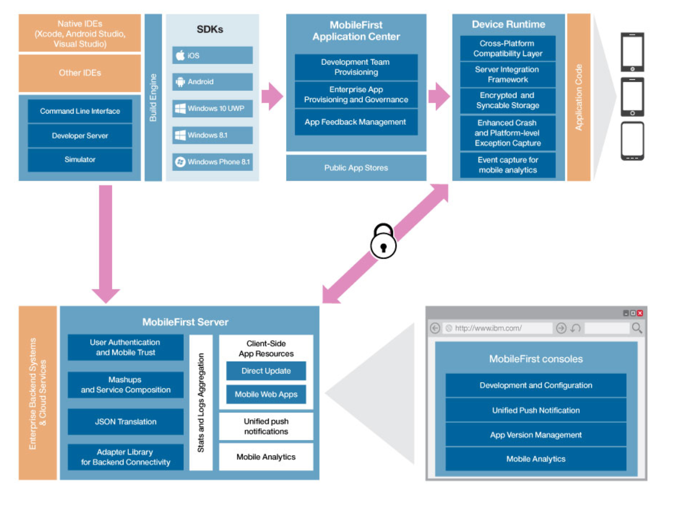
Architecture Overview
The following figure shows the components of Mobile Foundation:
High Level Configuration:
PHP Codeignator/MEAN Stack
HTML/AngularJS
MySQL/MS SQL (Data base)
Live stream: We propose free live stream modules from zoom, jitsi which can be integrated though with certain limitation in usage time and branding.
IBM Mobile First

Slide 9
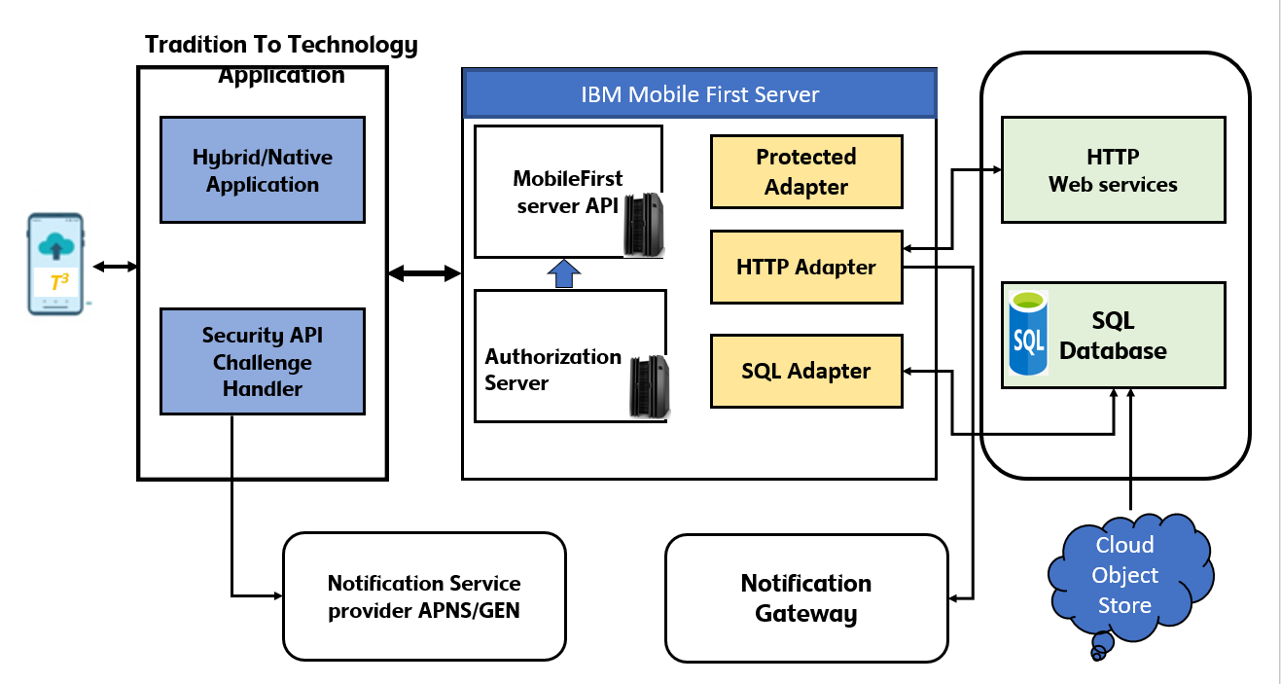
Architecture High level Design

Slide 10
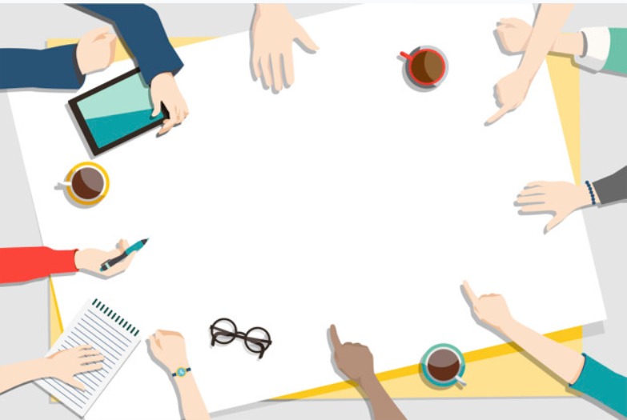

Roadmap
The Product
Feature Definition: Prioritizing, sizing, and documentation needed to start building. UX/UI Design: Provide designers with the UX research, Wireframes and specifications. Engineering: Build the key features most likely in a series of sprints. QA and Operations: Test and Deploy the new functionality in production.
Go To Market
Launch Date: Set a date and time for the launch and communicate to stakeholders. Pricing and Packaging: Approve the pricing for the new product. Design and how it bundled to present it to the customers. Positioning & Communication Marketing content, Social media & Media relations to provide key updates.
Systems
Infrastructure: Make necessary changes to internal monitoring systems, such as analytics or product administration Billing: Update existing billing options and functionality to accommodate the new product experience Finance: Update key systems to track financial metrics associated with the new product or upgrades that generate add-on revenue.

Slide 11
Roadmap
Sales and Support
Documentation: Complete and approve all product documentation, including release notes, help and troubleshooting guides, FAQs, and technical data sheets. Sales strategy and training Partners: Update and enable partners and affiliates to help communicate and promote the launch
Feedback
Review and Follow up: Survey users for their feedback. Solicit testimonials or success stories from customers (if relevant).

Slide 12
Financial Estimation*
Activities | Estimation (USD)
Development & Workshops | 1200
Hosting | 180,000
Advertising | 5000
Vendor Consultancy / System interfaces | 65,000
IT Project Management | 55,000
Contingency | +40%
*Budgetary

Slide 13
Competitive Comparison
Criteria | Meethi Katha | Facebook | Twitter | YouTube | Other story telling Mobile Apps for Kids
Purpose | Bridge the communication gap between the young and the older generation by providing a platform | Social Networking, connected with Friends and Family | Social Networking and Microblogging | Educational, Information, content sharing | Engaging Kids
Interactions | Provides an interactive platform for two specific segments to connect, share ideas, stories and life lessons | Facebook Live videos are 1:Many communication where one person is sharing a story but the other end is responding over comments or by liking. Not a direct 1:1 interaction. | Twitter is an interaction channel is 1:many and is based on reaction based approach for interaction. | One Way Interaction. The content is pre recorded and don’t have direct interaction capabilities | Pre-recorded stories mostly in animation format. Lacks human touch and live interaction and communication. One way interaction.
Min Age Criteria | 5 Years | Min Age Criteria is 13 Years | Min Age Criteria is 13 Years | Min Age Criteria is 13 Years | 3 Years
Target Population | A platform to connect the Kids and the elderly. 5-12 Years and 55- above | 13 Year and above. 27.4 % of users are of the age group 25-34 (Statista.com) | 13 Year and above. As per the latest demographic assessment 44% of users are of the age group 18-24 (sprout.com) | 13 Year and above. | Kids above the age of 3.

Slide 14
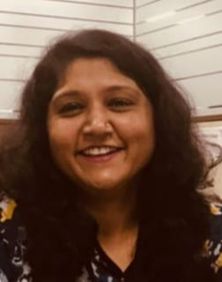
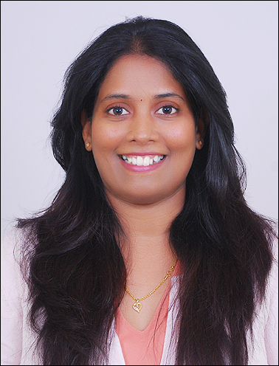
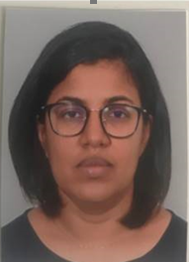
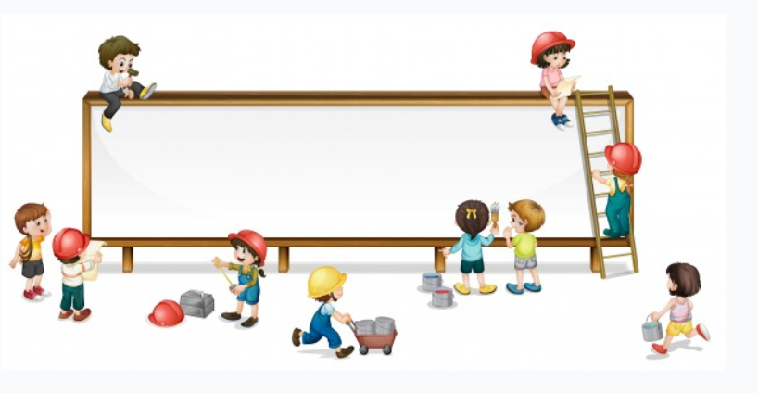
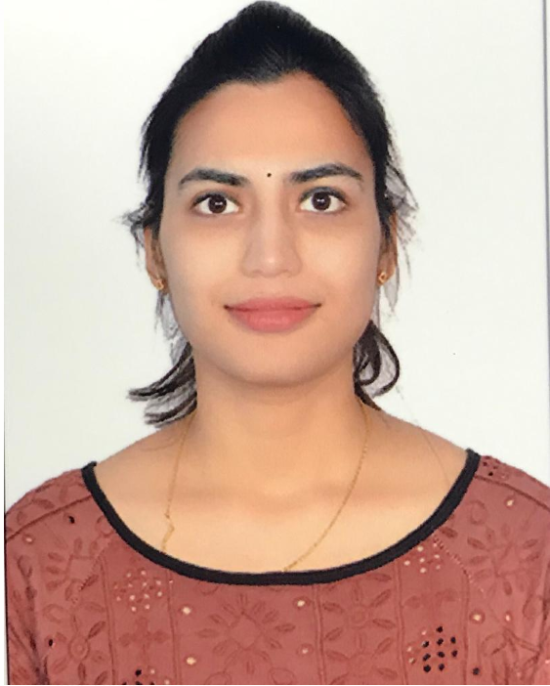
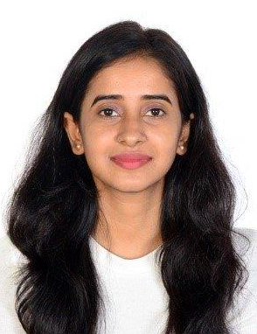
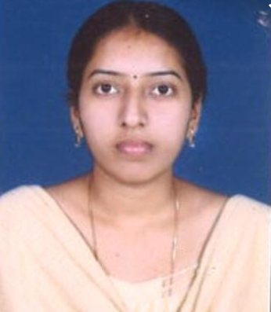
Meet The Team
Anupama Rao
(Mentor)
Kiranmayee
Tulluru
Chandrika
Sureddy
Crisis Starlet
Deepthi
Mangipudi
Disha
Kashyap
Mohini
Vemulamanda

Slide 15
Anupama.rao@rb.com
Contact
www.rb.com
Skyview 20, Hyderabad

Slide 16
Thank You !!

